Slide 1
Short Term STOCK Price Prediction Using LSTM and GRU : A comparative Study
Central DepartMent of CompUter SCIENCE and INFORmation Technology
Submitted BY :
HIMAL Raj Gentil
Roll No: 6/075

Slide 2
Introduction
Stock Market is a place where shares or stock of firm are traded.
Interesting and very important study area but due to its complexity and dynamicity.
Many researchers have worked and proposed their ideas to forecast the market price, various techniques such as statistical and technical analysis.
Factors influencing the market value in a day includes country’s economic change, product value, investor’s sentiments, weather, political affairs, etc.
In this seminar project, two variants of RNN i.e. LSTM and GRU are used to predict short term stock price prediction.

Slide 3
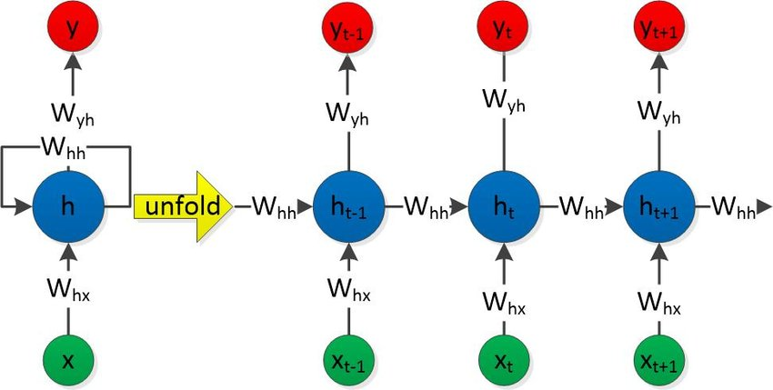

RNN (Recurrent Neural Network)
Fig 1: Sample RNN Structure
Input Time Series: $X = \left\{x_{1},x_{2},….{,x}_{T}\right\}$
Hidden State Sequence: $h = \left\{h_{1},h_{2}….,h_{T}\right\}$
Output Sequence: $y = \{y_{1},y_{2}….,y_{T}\}$
$$h_{t}=g_{n}(W_{hx}X_{t}+W_{hh}h_{t−1}+b_{h})$$
$$y_{t}=g_{n}(W_{yh}h_{t}+b_{y})$$

Slide 4
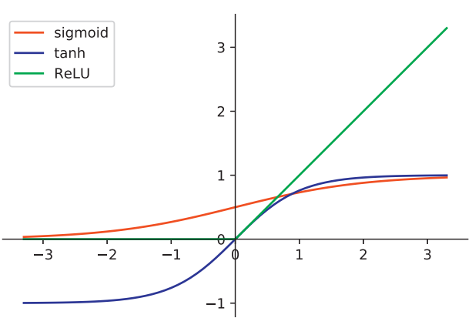

RNN Contd…
Fig 2: Activation Functions
Activation Functions :
$sigmod(x)=\frac{1}{1+e^{−x}}$ , Range(0,1)
$tanh (x) = 2sigmoid(2x) – 1$ , Range(-1,1)
$ReLU(x)=max\{0,x\}$

Slide 5
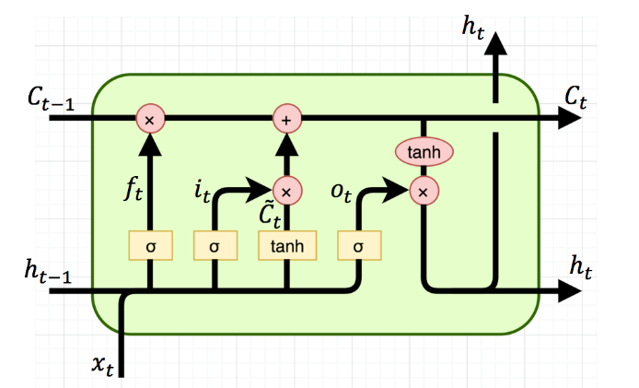

LSTM
Fig 3: LSTM Cell
Here $C_{t−1}$: old cells state, $C_{t}$: present cell state, $h_{t−1}$: output of previous cell, $h_{t}$ : Output of present cell, $i_{t}$ : Input gate layer, $f_{t}$ : forget gate layer, $O_{t}$ : output sigmoid gate layer

Slide 6
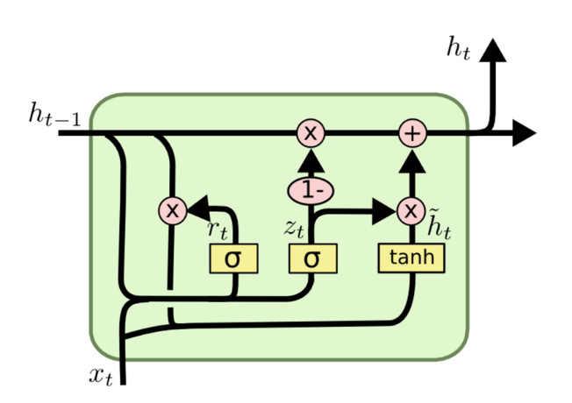

GRU
Here $h_{t−1}$: output of previous cell, $h_{t}$ : Output of present cell, $z_{t}$ : update sigmoid gate layer, $r_{t}$ : reset sigmoid gate layer
Fig 4: GRU Cell

Slide 7
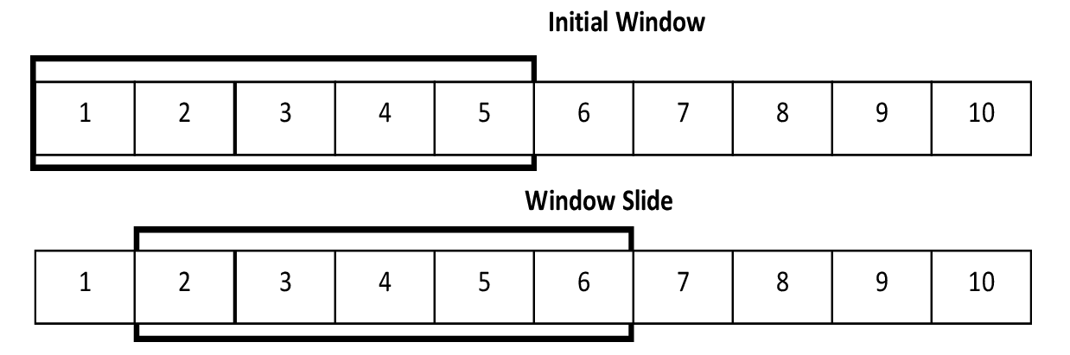

Sliding Window Method
Fig 5: Sliding Window
A way to restructure a time series as supervised problem
converts the sequential supervised learning problem into the classical supervised learning problem.
It constructs a window model $h_{w}$, that maps an input window of width $w$ into an individual output value y. Specifically, let $d=(w−1)/2$ be the “half-width” of the window. Then $h_{w}$ predicts $y_{i,t}$ using the window ($x_{i,t−d}, x_{i,t−d+1}, …….x_{i,t},……x_{i,t−d−1}, x_{i,t+d}$).

Slide 8
Literature Review
During Pre-Deep Learning era, Financial Time Series modelling has mainly concentrated in the field of linear models.
The most commonly used linear model, ARIMA was proposed by Box and Jenkins in 1976.
The first attempt to model a financial time series using a neural network was by H. White in 1988. This work made an attempt for decoding the non linear regularities in asset price movement for IBM.
In 1996, J. Roman and A. Jameel used back propagation and RNN models for the prediction for five different stock markets.
Hengjian Jia found that LSTMs learns patterns effective for stock market prediction and he obtained descent RMSEs with different architectures of LSTM. This study helped in realization of this problem, and gave an insight to solve this problem using Sliding Window Method.

Slide 9
LITERature Review (Contd…)
A. Dutta with his team have applied GRU for the bitcoin price prediction . They have obtained quite promising results with Test RMSE of 0.017.
RNN with Gated Recurrent Units (GRU) have been applied for stock price movement prediction in some recent works by D. Duong with his colleagues and have shown promising success. Bidirectional Gated Recurrent Unit (BGRU) have been used to predict stock price movements, and their model achieved accuracy of nearly 60% in S&P500 index prediction and the individual stock prediction is over 65%.
From the motivation of success of deep RNN with LSTM and GRU units in different areas to model sequence data, in this study, it is attempted to experiment with RNN with LSTM and GRUs to predict future stock price based on previous days data. The proposed method focuses on predicting stock price for Apple Inc., Amazon.com Inc. and Ford Motors Company. The approach adopted is a sliding window approach with data overlap.

Slide 10
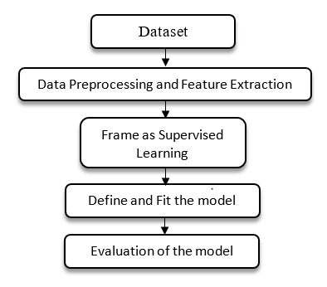
Methodology
Fig 6: Methodology

Slide 11
Dataset
Dataset is taken from highly traded stocks of three different sectors which are Tech, E-commerce and Manufacturing sector. The corresponding stocks from these sectors are Apple Inc., Amazon.com Inc., and Ford Motors Coompany.
Each contains information like trading day date, Open, High, Low, Close, Adj.Close, and Volume. The data sets contain the data from 2012-Jan-03 to 2020-Nov-24.
The data sets were made available from yahoo finance api and fetched using pandas data reader python library.

Slide 12

Data Preprocessing and Feature Selection
The data was normalized into the range of [0, 1]
$$X_{std}=\frac{X−X_{std}}{X_{max}−X_{min}}$$
$$X_{scaled}= X_{std}∗\left(max−min\right)+min$$
$$Where min=0 and max =1$$
Pearson Correlation Coefficient was used for finding the correlation between data.
$$r_{x,y}=\frac{\sum_{i=1}^{n}{(x_{i}−\overline{x})(}y_{i}−\overline{y})}{\sqrt{{\sum_{i=1}^{n}{(x_{i}−\overline{x})}}^{2}}\sqrt{{\sum_{i=1}^{n}{(y_{i}−\overline{y})}}^{2}}}$$
Where, $n$ is the sample size ,$x_{i},y_{i}$ are individual sample points indexed with $i$, $\overline{x}$ is the sample mean

Slide 13
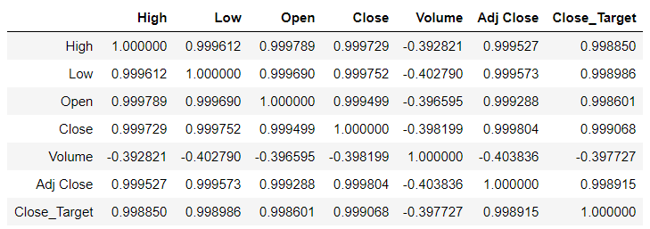
Data Preprocessing and Feature Selection (Contd…)
Table 1 : Correlation Test for Apple Inc. Dataset

Slide 14
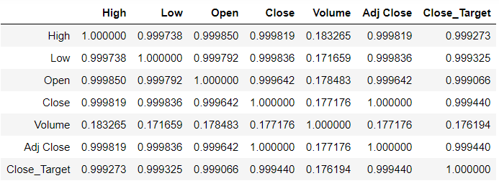
Data Preprocessing and Feature Selection (Contd…)
Table 2: Correlation Test for Amazon.com Inc. Dataset

Slide 15
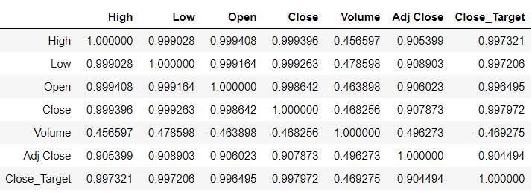
Data Preprocessing and Feature Selection (Contd…)
Table 3: Correlation Test for Ford Motors Company Dataset

Slide 16
Framing as Supervised Learning
The dataset is split into training and testing set. For training set first 80% of the dataset is allocated and for testing rest 20% of the dataset is chosen.
dataset was framed as per the sliding window method and single step forecasting models of RNN with LSTM and GRU are adopted for prediction. In single step forecasting historical observations (t-1, t-2, … t-n) forecast t.
Window size of 60 is taken for the sliding window.

Slide 17
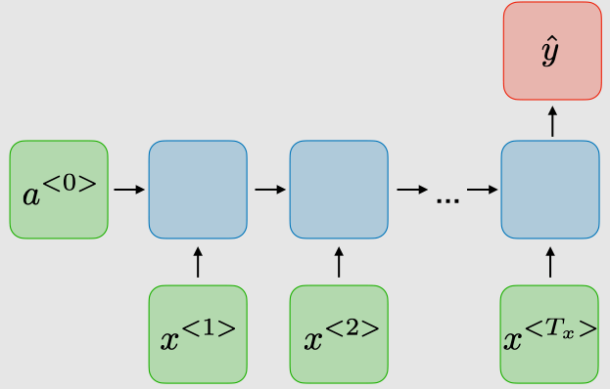
Model Architecture and Fitting the Model
Fig 7: Model Archotecture
Two LSTM/GRU layers with 50 neurons and two Dense layers, one with 25 neurons and the other with 1 neuron
Moreover, Adam optimizer is used, learning rate is set to 0.001.
Appropriate epochs are used to train the models on Google Colab, running over Google Cloud Platform (GCP) to obtain the best fit for each model.

Slide 18
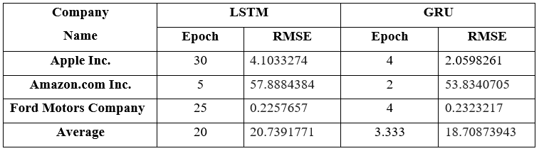
Results and Analysis
Table 4: Results and Analysis

Slide 19
CONCLUSION
From the comparison of both models, its found that GRU outperforms LSTM during both training and testing phase.
The GRU model takes 74.41% less epochs during training than LSTM and also performs 26.77 % more accurate prediction than LSTM.
Future Works .

Slide 20
References
[1] Li, R., Fu, D., & Zheng, Z. (2017). An analysis of the correlation between internet public opinion and stock market. 2017 4th International Conference on Information Science and Control Engineering (ICISCE). https://doi.org/10.1109/icisce.2017.41
[2] Tiwari, V., Tiwari, V., Gupta, S., & Tiwari, R. (2010). Association rule mining: A graph based approach for mining frequent itemsets. 2010 International Conference on Networking and Information Technology. https://doi.org/10.1109/icnit.2010.5508505
[3] Kunal, S., Saha, A., Varma, A., & Tiwari, V. (2018). Textual dissection of live Twitter reviews using naive Bayes. Procedia Computer Science, 132, 307-313. https://doi.org/10.1016/j.procs.2018.05.182
[4] Basak, S., Kar, S., Saha, S., Khaidem, L., & Dey, S. R. (2019). Predicting the direction of stock market prices using tree-based classifiers. The North American Journal of Economics and Finance, 47, 552-567. https://doi.org/10.1016/j.najef.2018.06.013
[5] Pandas-datareader — pandas-datareader 0.9.0rc1+2.g427f658 documentation. (n.d.). pandas-datareader — pandas-datareader 0.9.0rc1+2.g427f658 documentation. https://pandas-datareader.readthedocs.io/en/latest/
[6] Jian Zheng, Cencen Xu, Ziang Zhang, & Xiaohua Li. (2017). Electric load forecasting in smart grids using long-short-Term-Memory based recurrent neural network. 2017 51st Annual Conference on Information Sciences and Systems (CISS). https://doi.org/10.1109/ciss.2017.7926112
[7] M, H., E.A., G., Menon, V. K., & K.P., S. (2018). NSE stock market prediction using deep-learning models. International Conference on Computational Intelligence and Data Science (ICCIDS 2018),Procedia Computer Science, 132, 1351-1362. https://doi.org/10.1016/j.procs.2018.05.050
[8] Zachary C. Lipton, John Berkowitz, & Charles Elkan. (n.d.). A critical review of recurrent neural networks for sequence learning. arXiv.org. https://arxiv.org/abs/1506.00019v4
[9] Gao, X., Shi, M., Song, X., Zhang, C., & Zhang, H. (2019). Recurrent neural networks for real-time prediction of TBM operating parameters. Automation in Construction, 98, 225-235. https://doi.org/10.1016/j.autcon.2018.11.013
[10] Pascanu, R., Mikolov, T., & Bengio, Y. (n.d.). On the difficulty of training recurrent neural networks. arXiv.org. https://arxiv.org/abs/1211.5063v2
[11] Guresen, E., Kayakutlu, G., & Daim, T. U. (2011). Using artificial neural network models in stock market index prediction. Expert Systems with Applications, 38(8), 10389-10397. https://doi.org/10.1016/j.eswa.2011.02.068

Slide 21
References (CONTD…)
[12] Shen, G., Tan, Q., Zhang, H., Zeng, P., & Xu, J. (2018). Deep learning with gated recurrent unit networks for financial sequence predictions. Procedia Computer Science, 131, 895-903. https://doi.org/10.1016/j.procs.2018.04.298
[13] Cho, K., Van Merrienboer, B., Gulcehre, C., Bahdanau, D., Bougares, F., Schwenk, H., & Bengio, Y. (2014). Learning phrase representations using RNN encoder–decoder for statistical machine translation. Proceedings of the 2014 Conference on Empirical Methods in Natural Language Processing (EMNLP). https://doi.org/10.3115/v1/d14-1179
[14] Wang, Y., Liao, W., & Chang, Y. (2018). Gated recurrent unit network-based short-term photovoltaic forecasting. Energies, 11(8), 2163. https://doi.org/10.3390/en11082163
[15] Box, G. Box and jenkins: Time series analysis, forecasting and control. In A Very British Affair: Six Britons and the Development of Time Series Analysis during the 20th Century; Palgrave Macmillan: London, UK, 2013; pp. 161–215, ISBN 978-1-137-29126-4.
[16] De Gooijer, J. G., & Hyndman, R. J. (2006). 25 years of time series forecasting. International Journal of Forecasting, 22(3), 443-473. https://doi.org/10.1016/j.ijforecast.2006.01.001
[17] Menon, V. K., Chekravarthi Vasireddy, N., Jami, S. A., Pedamallu, V. T., Sureshkumar, V., & Soman, K. P. (2016). Bulk price forecasting using spark over NSE data set. Data Mining and Big Data, 137-146. https://doi.org/10.1007/978-3-319-40973-3_13
[18] Wilson, G. T. (2016). Time series analysis: Forecasting and control, 5th edition, by George E. P. Box, Gwilym M. Jenkins, Gregory C. Reinsel and Greta M. Ljung, 2015. Published by John Wiley and sons Inc., Hoboken, New Jersey, pp. 712. ISBN: 978-1-118-67502-1. Journal of Time Series Analysis, 37(5), 709-711. https://doi.org/10.1111/jtsa.12194
[19] White, H.(1988). Economic Prediction Using Neural Networks: The Case of IBM Daily Stock Returns, ser. Discussion paper- Department of Economics University of California San Diego. Department of Economics, University of California.
[20] Heaton, J., & Polson, N. (2016). Deep learning for finance: Deep portfolios. SSRN Electronic Journal. https://doi.org/10.2139/ssrn.2838013
[21] Roman, J., & Jameel, A. (1996). Backpropagation and recurrent neural networks in financial analysis of multiple stock market returns. Proceedings of HICSS-29: 29th Hawaii International Conference on System Sciences. https://doi.org/10.1109/hicss.1996.495431

Slide 22
References (Contd…)
[22] Hengjian, J., Investigation Into The Effectiveness Of LongShort Term Memory Networks For Stock Price Prediction, arXiv:1603.07893v3 [cs.NE].
[23] Naeini, M. P., Taremian, H., & Hashemi, H.B. (2010). Stock market value prediction using neural networks. 2010 International Conference on Computer Information Systems and Industrial Management Applications (CISIM). https://doi.org/10.1109/cisim.2010.5643675
[24] Dutta, A., Kumar, S., & Basu, M. (2020). A gated recurrent unit approach to bitcoin price prediction. Journal of Risk and Financial Management, 13(2), 23. https://doi.org/10.3390/jrfm13020023
[25] H. D. Huynh, L. M. Dang, and D. Duong, A new model for stock price movements prediction using deep neural network. Proceedings of the Eighth International Symposium on Information and Communication Technology. ACM, 2017, pp. 57–62.
[26] Keras Team. (n.d.). Keras documentation: Keras API reference. Keras: the Python deep learning API. https://keras.io/api/
[27] D. P. Kingma and J. Ba., Adam: A method for stochastic optimization, arXiv preprint arXiv:1412.6980, 2014.
[28] (n.d.). Yahoo Finance - Stock Market Live, Quotes, Business & Finance News. https://finance.yahoo.com/
[29] Pandas-datareader — pandas-datareader 0.9.0rc1+2.g427f658 documentation. (n.d.). pandas-datareader — pandas-datareader 0.9.0rc1+2.g427f658 documentation. https://pandas-datareader.readthedocs.io/en/latest/
[30] Sklearn.preprocessing.MinMaxScaler — scikit-learn 0.24.1 documentation. (n.d.). scikit-learn: machine learning in Python — scikit-learn 0.16.1 documentation. Retrieved February 13, 2021,from https://scikitlearn.org/stable/modules/generated/sklearn.preprocessing.MinMaxScaler.html
[31] Dietterich, T. G. (2002). Machine Learning for Sequential Data: A Review. Oregon State University, Corvallis, Oregon, USA,. : http://www.cs.orst.edu/~tgd

Slide 23
References (Contd …)
[32] Khare, K., Darekar, O., Gupta, P., & Attar, V. Z. (2017). Short term stock price prediction using deep learning. 2017 2nd IEEE International Conference on Recent Trends in Electronics, Information & Communication Technology (RTEICT). https://doi.org/10.1109/rteict.2017.8256643
[33] Halkjaer, S., & Winther, O. (n.d.). The effect of correlated input data on the dynamics of learning. The Niels Bohr Institute Blegdamsvej 17 2100 Copenhagen, Denmark . halkjaer,winther@connect.nbi.dk
[34] CS 230 - Recurrent neural networks Cheatsheet. (n.d.). Stanford University. https://stanford.edu/~shervine/teaching/cs-230/cheatsheet-recurrent-neural-networks
[35] Time series data prediction using sliding window based RBF neural network. (n.d.). Semantic Scholar | AI-Powered Research Tool. https://www.semanticscholar.org/paper/Time-Series-Data-Prediction-Using-Sliding-Window-Hota-Handa/91037f01fd4b845eadca0b53f5dc00d9f61ac493

Slide 24
Thank YOU

